Slide 1
Raymond Daniel Baer
1927-2018
a Millersburg man, a baseball player
a husband, a father, a sinner saved by grace
You could depend on Mim Baer.

Slide 2
Superior Blues

Slide 3
Nelson’s Express

Slide 4
a tough curve ball in relief

Slide 5
summer ball out west
Topeka Owls
Superior Blues

Slide 6
1952 Northern League Champs
Superior Blues

Slide 7
Fireman Ray Baer vs. the very young Henry Aaron
Eau Claire Bears rookie sensation at shortstop, on his way to becoming Hammerin’ Hank, meets Millersburg’s Mim Baer.

Slide 8
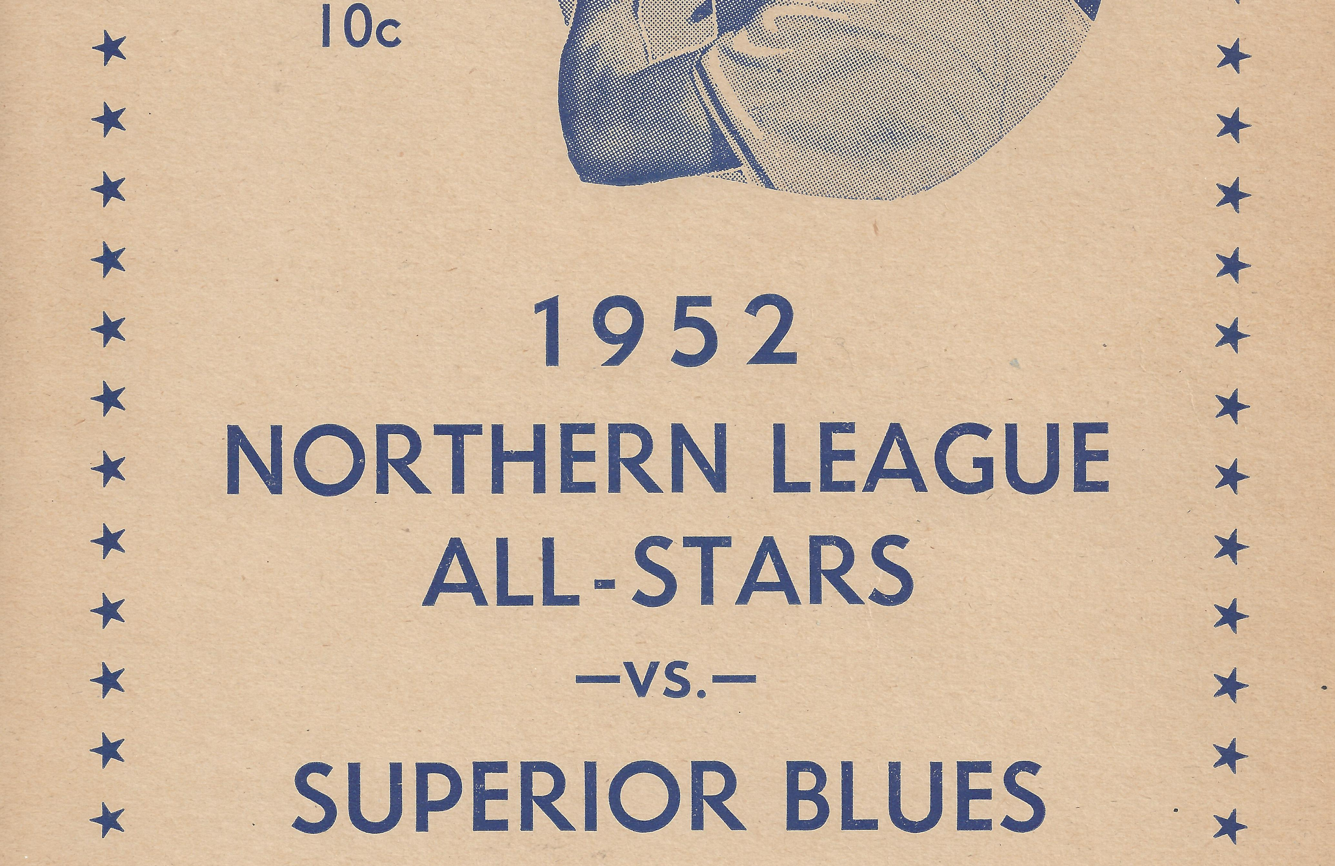

Slide 9
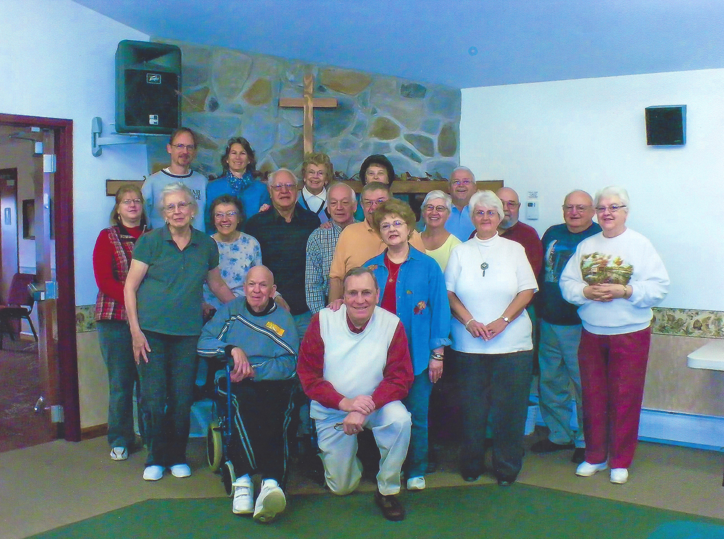
DCBC Twin Pines Retreat

Slide 10
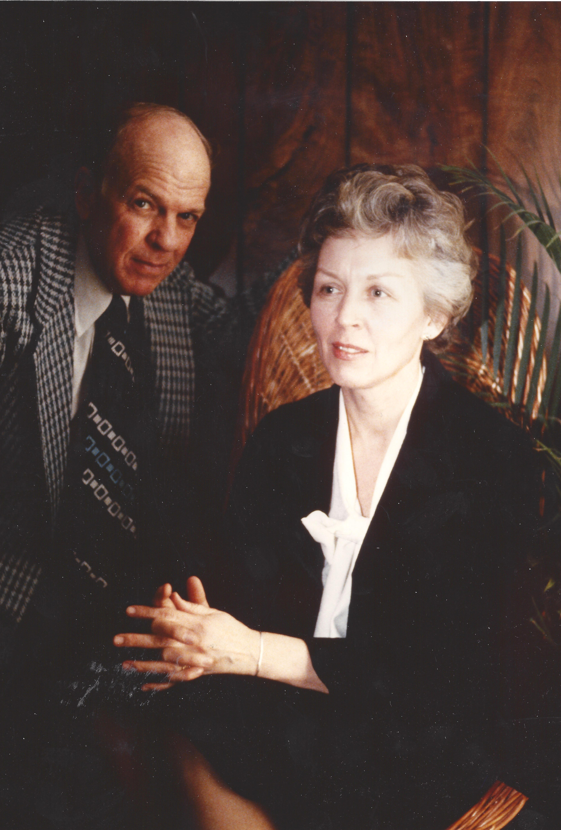

Slide 11
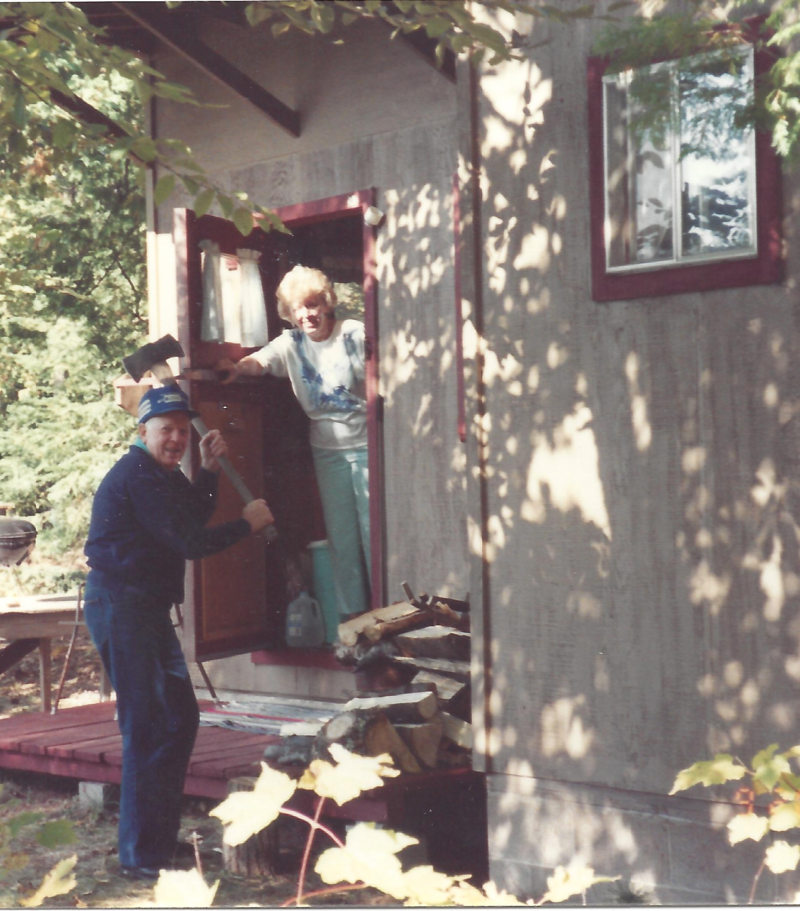
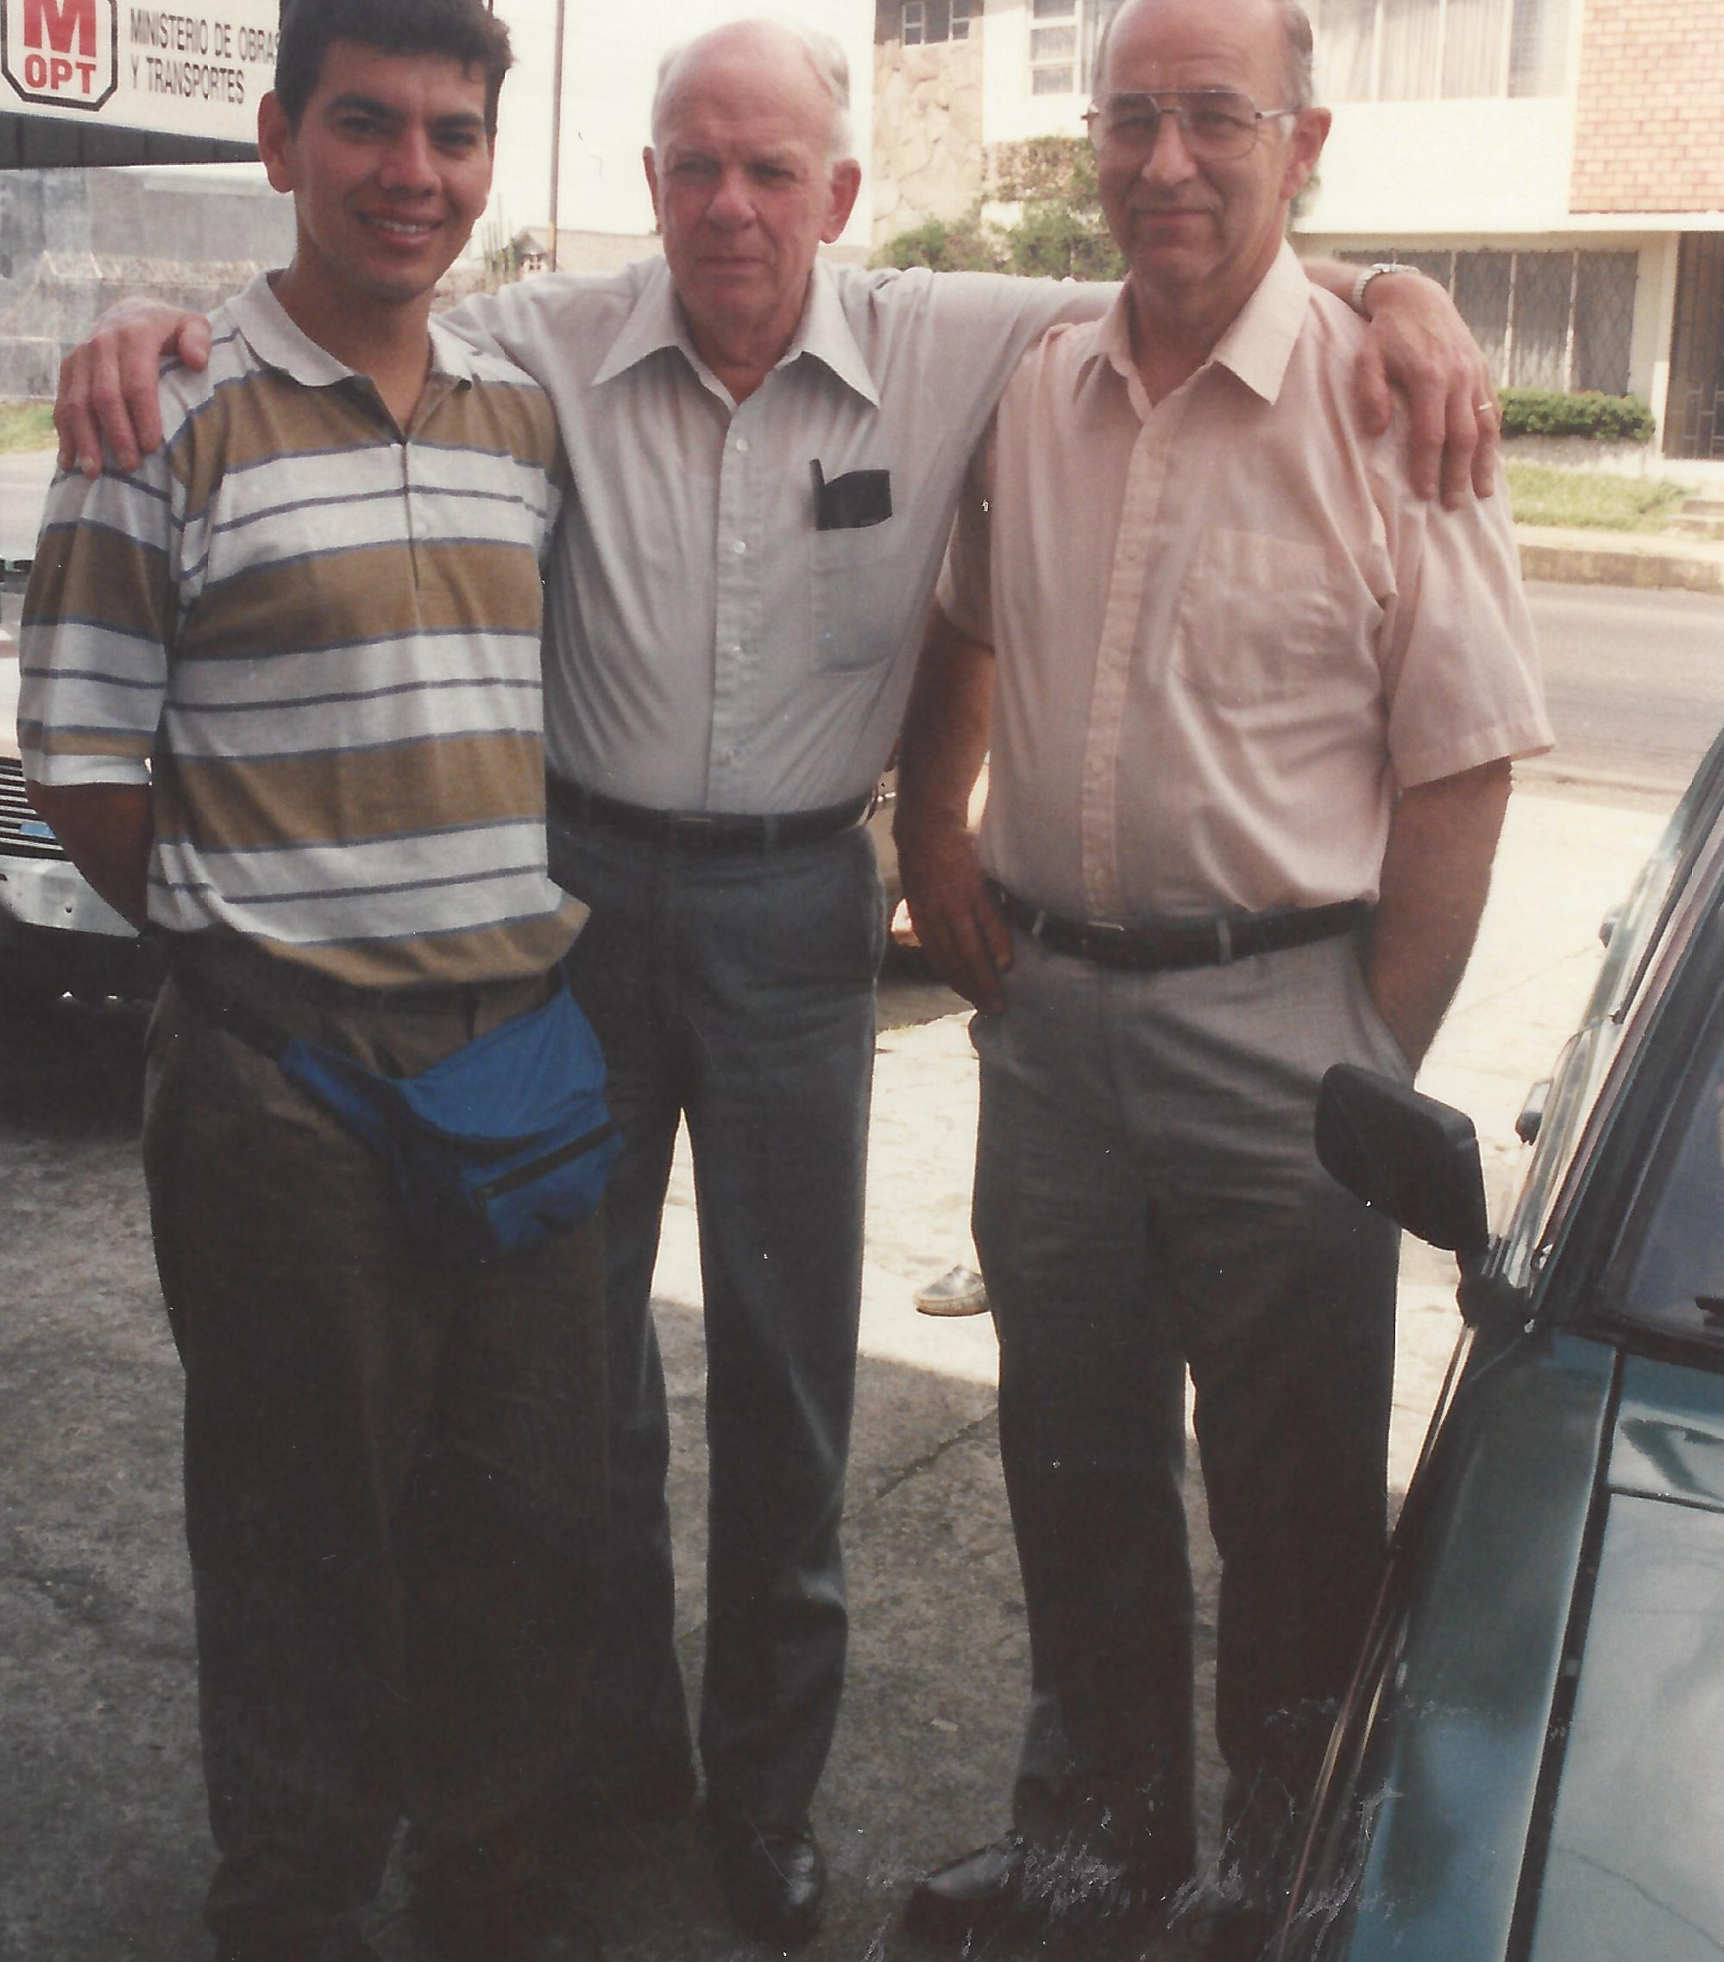

Slide 12
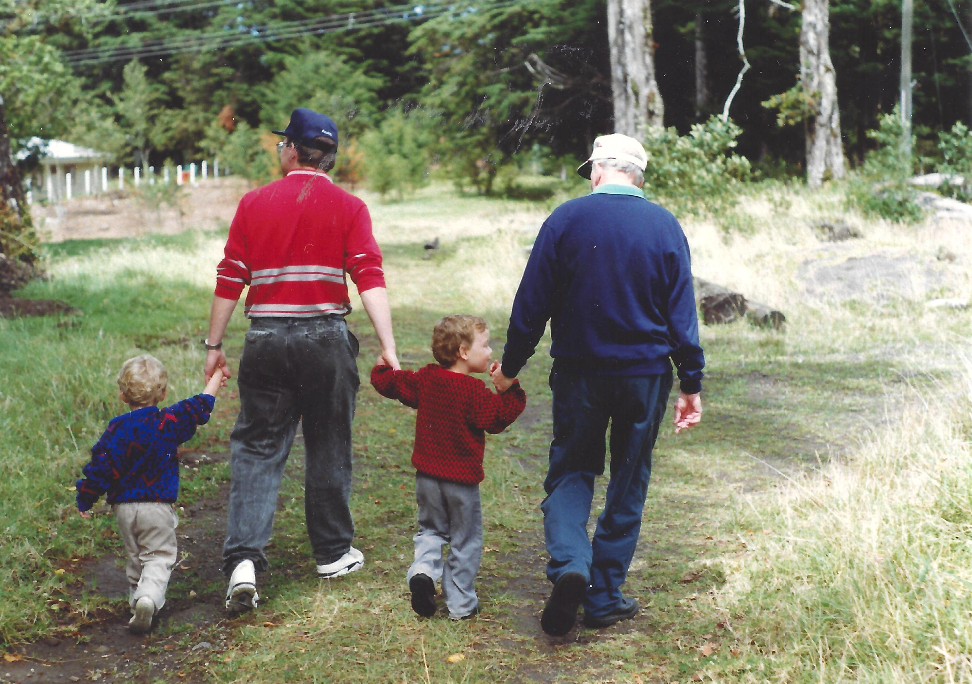
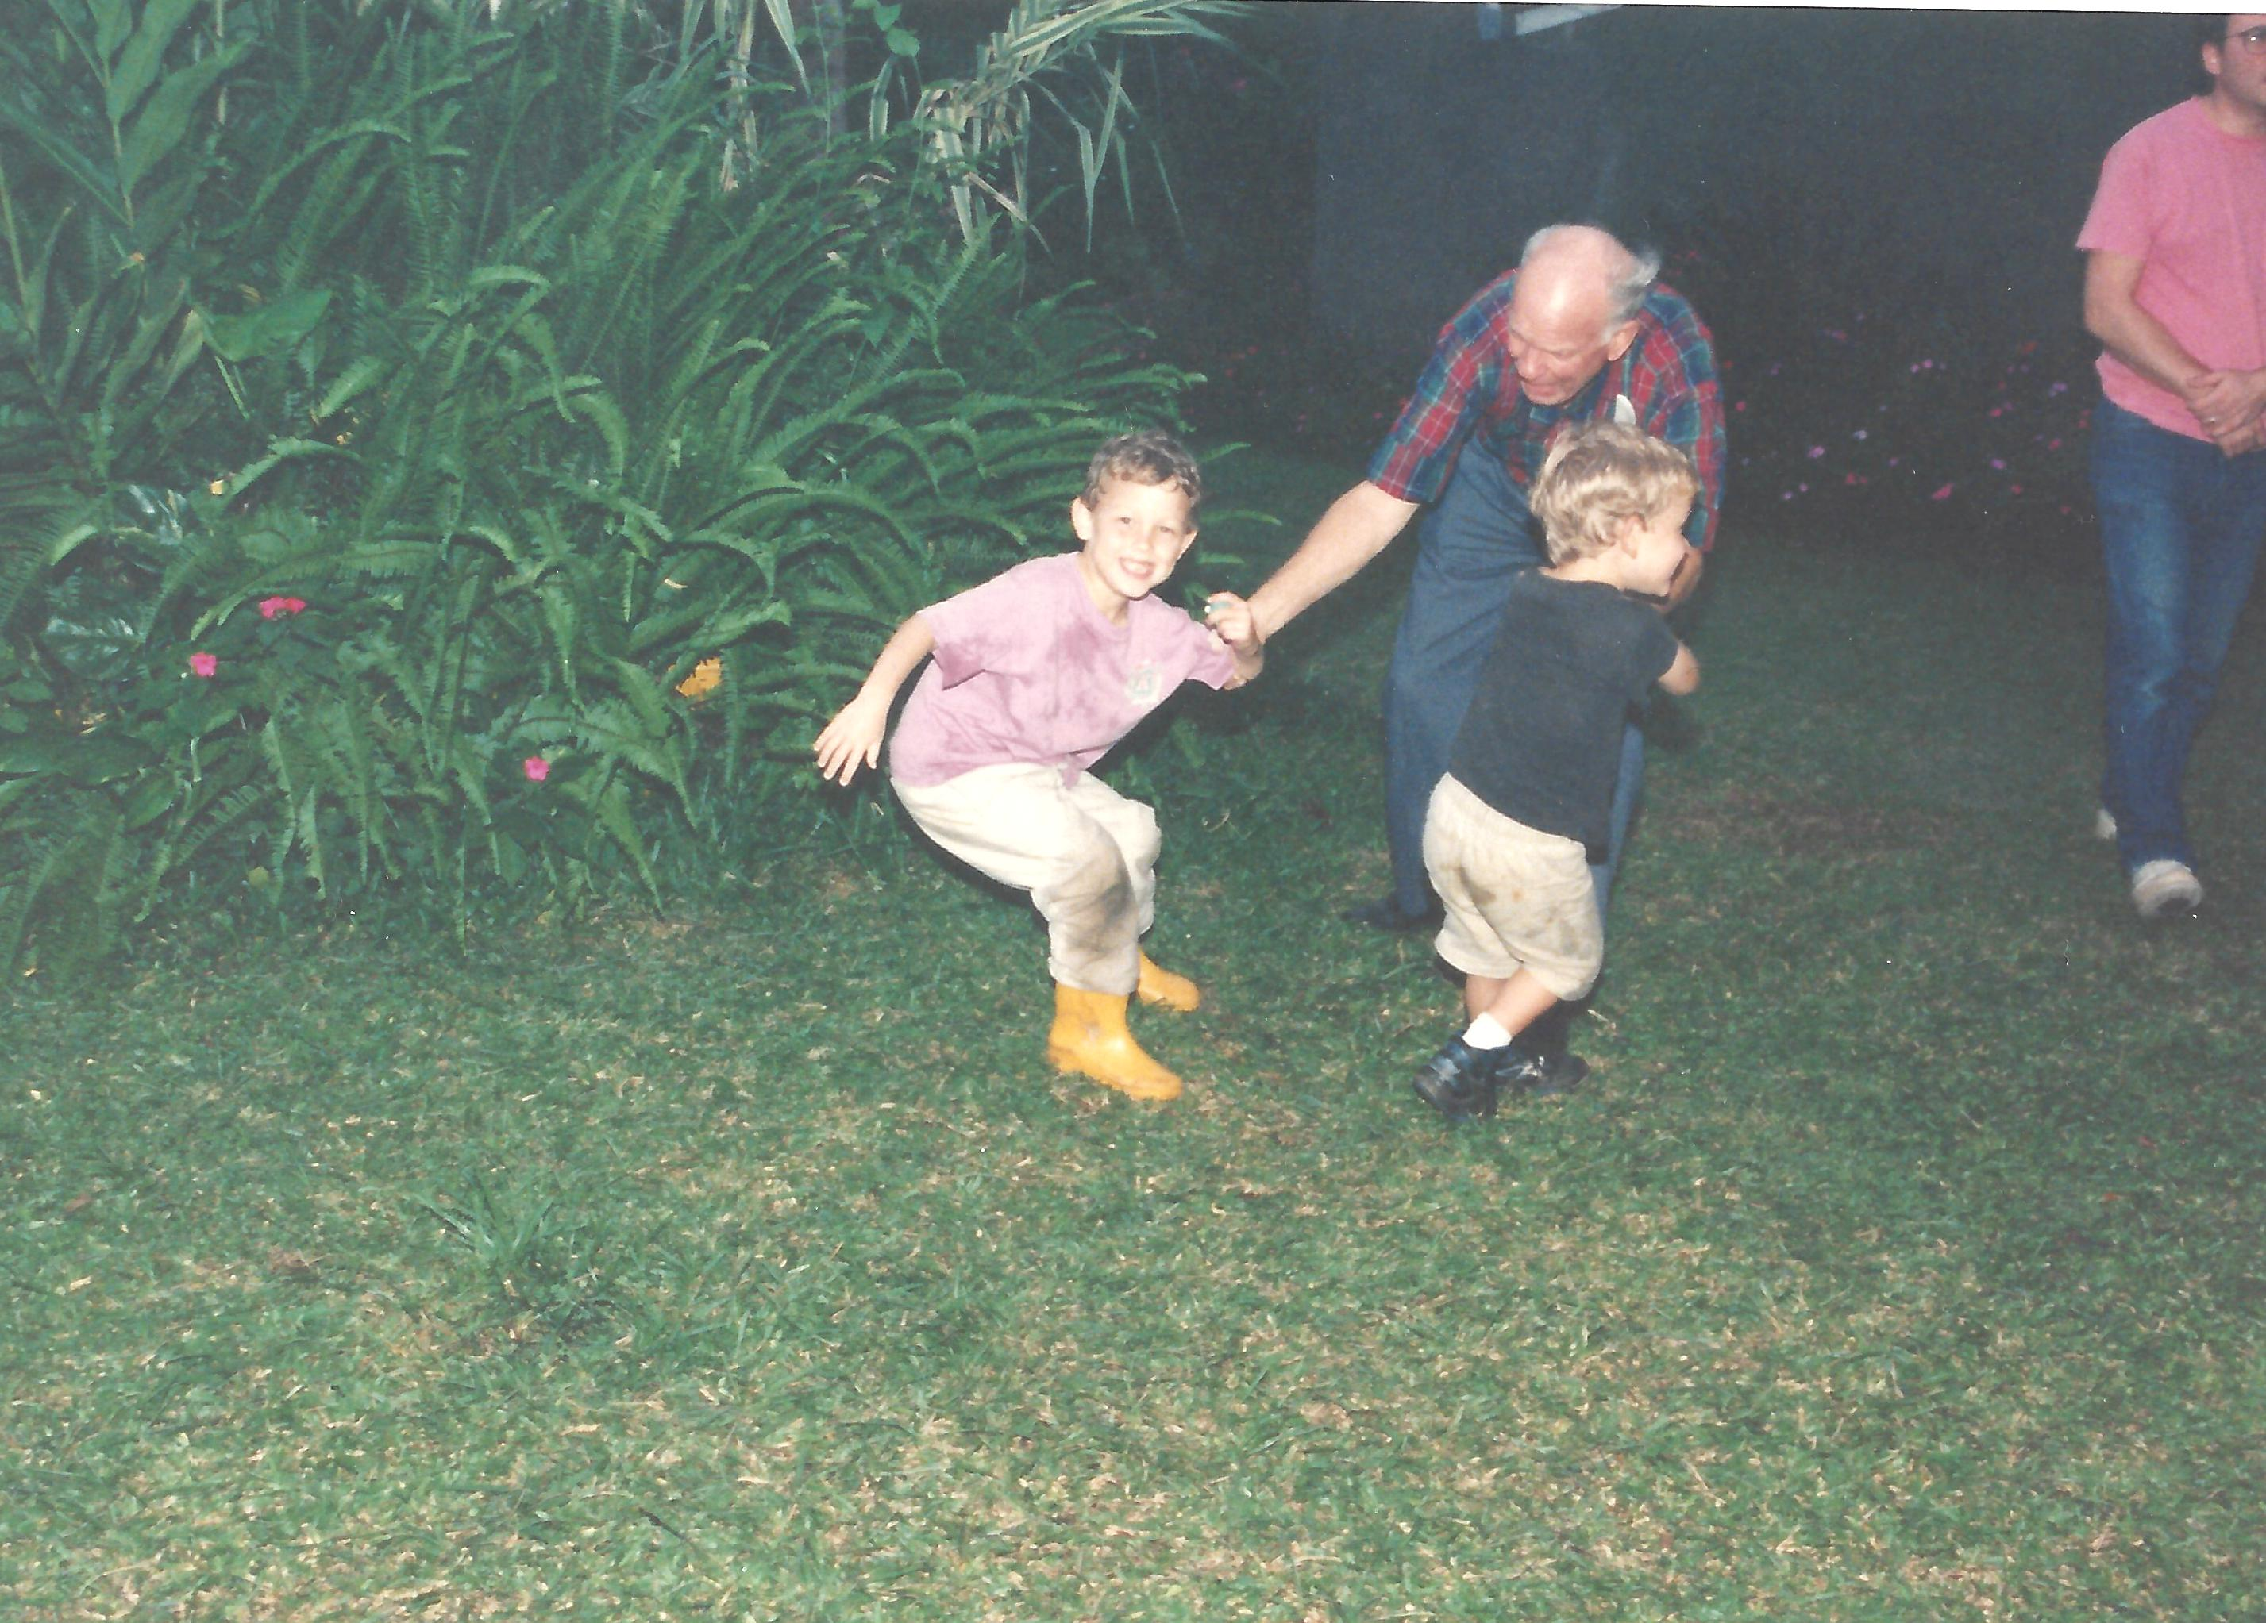

Slide 13
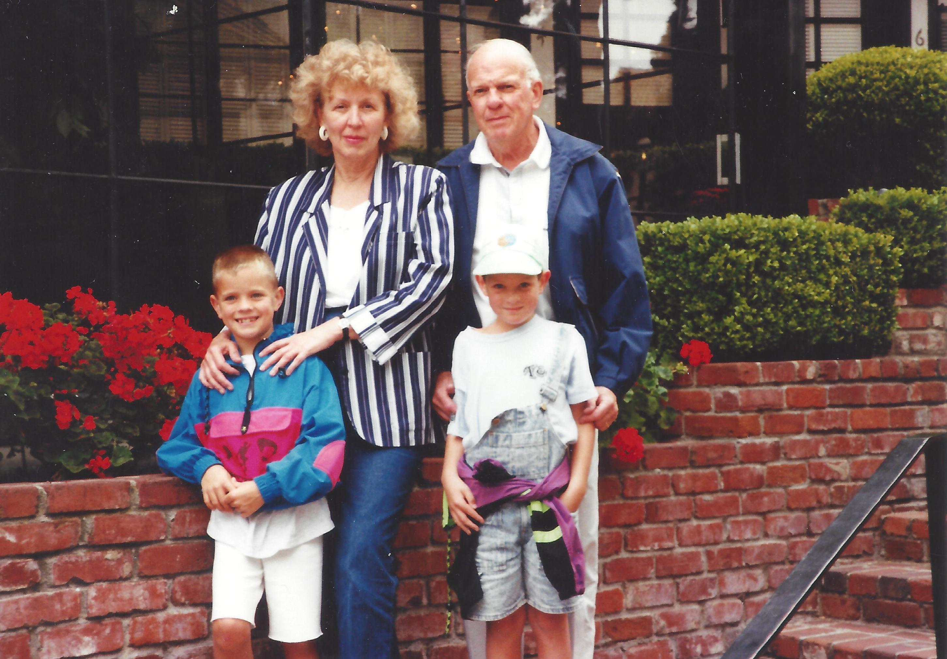
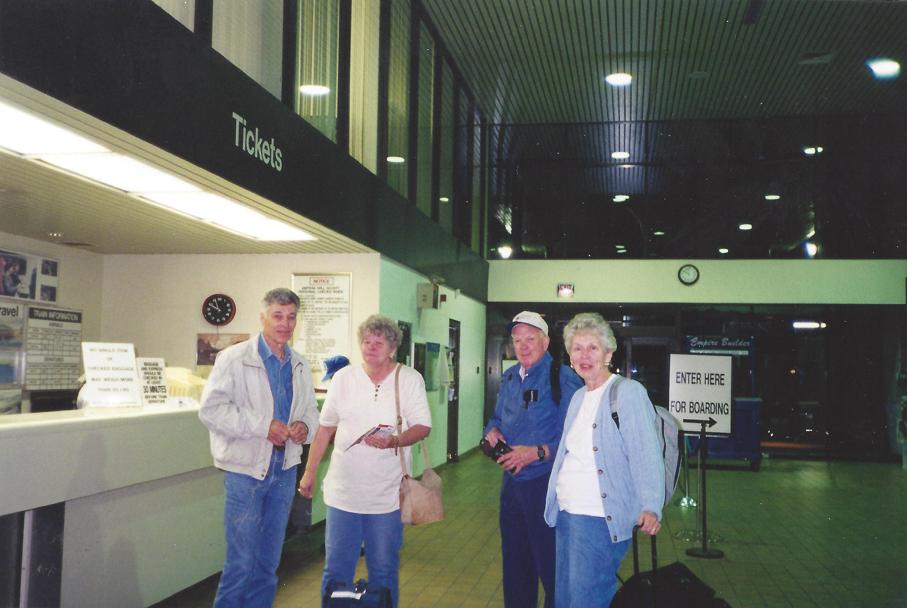

Slide 14
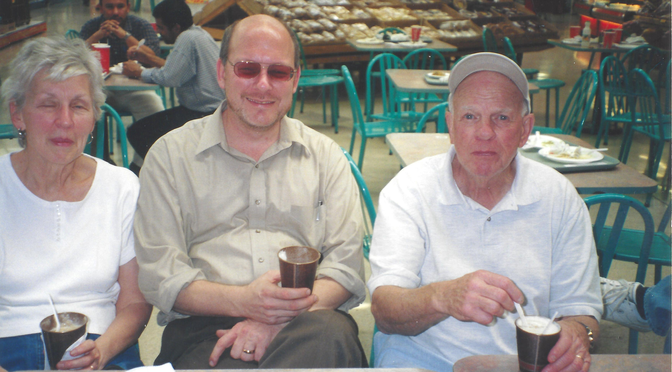

Slide 15
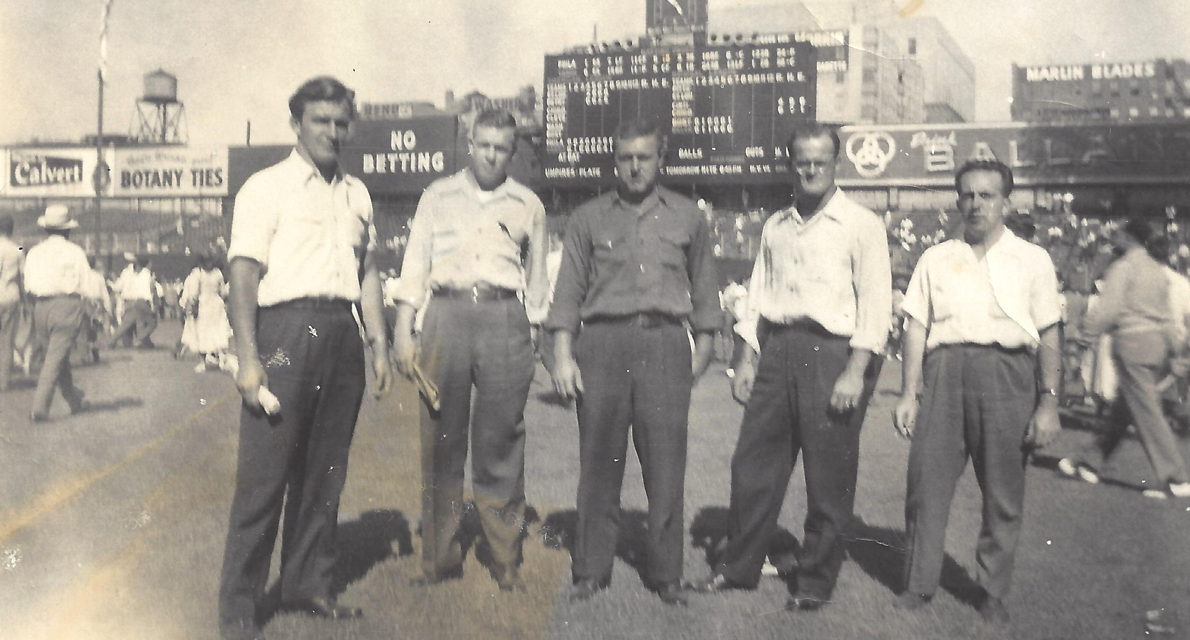
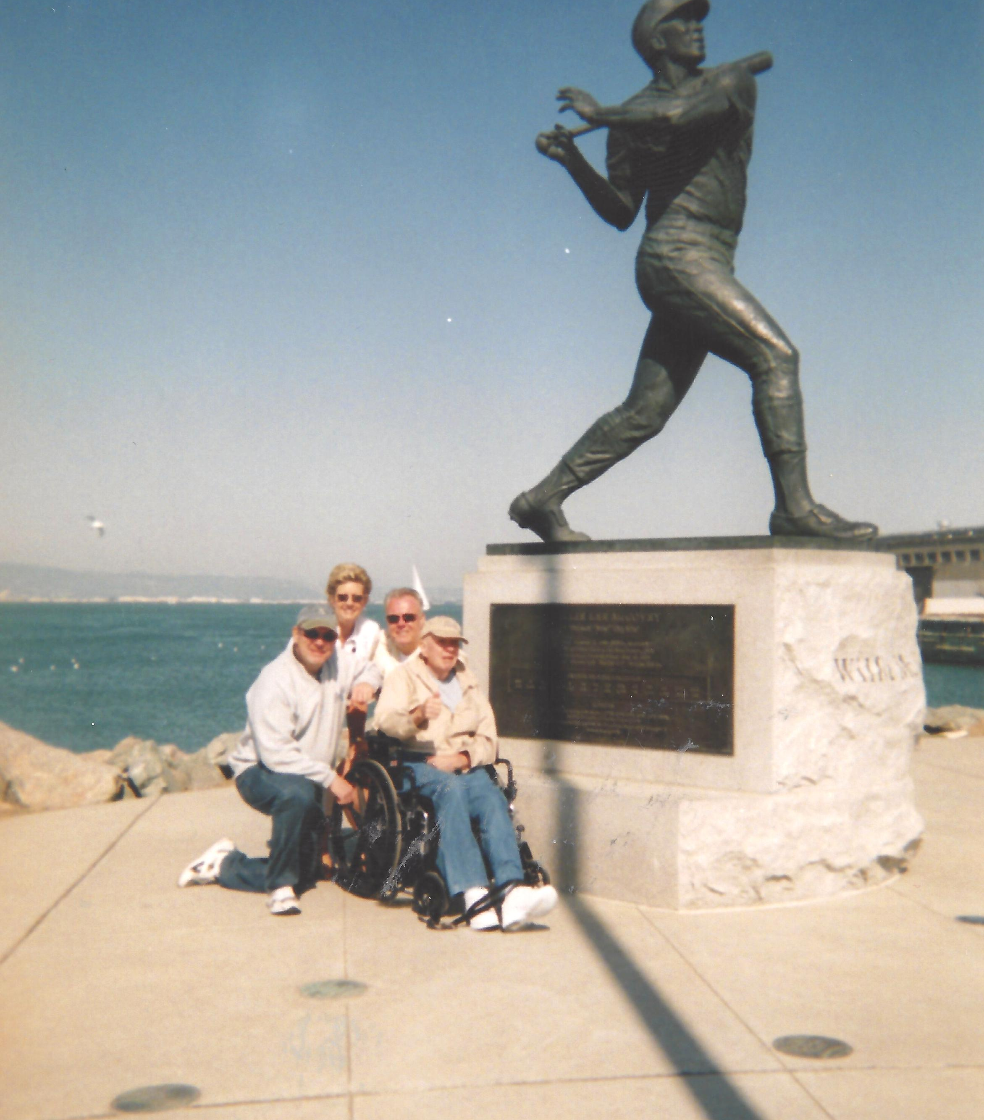
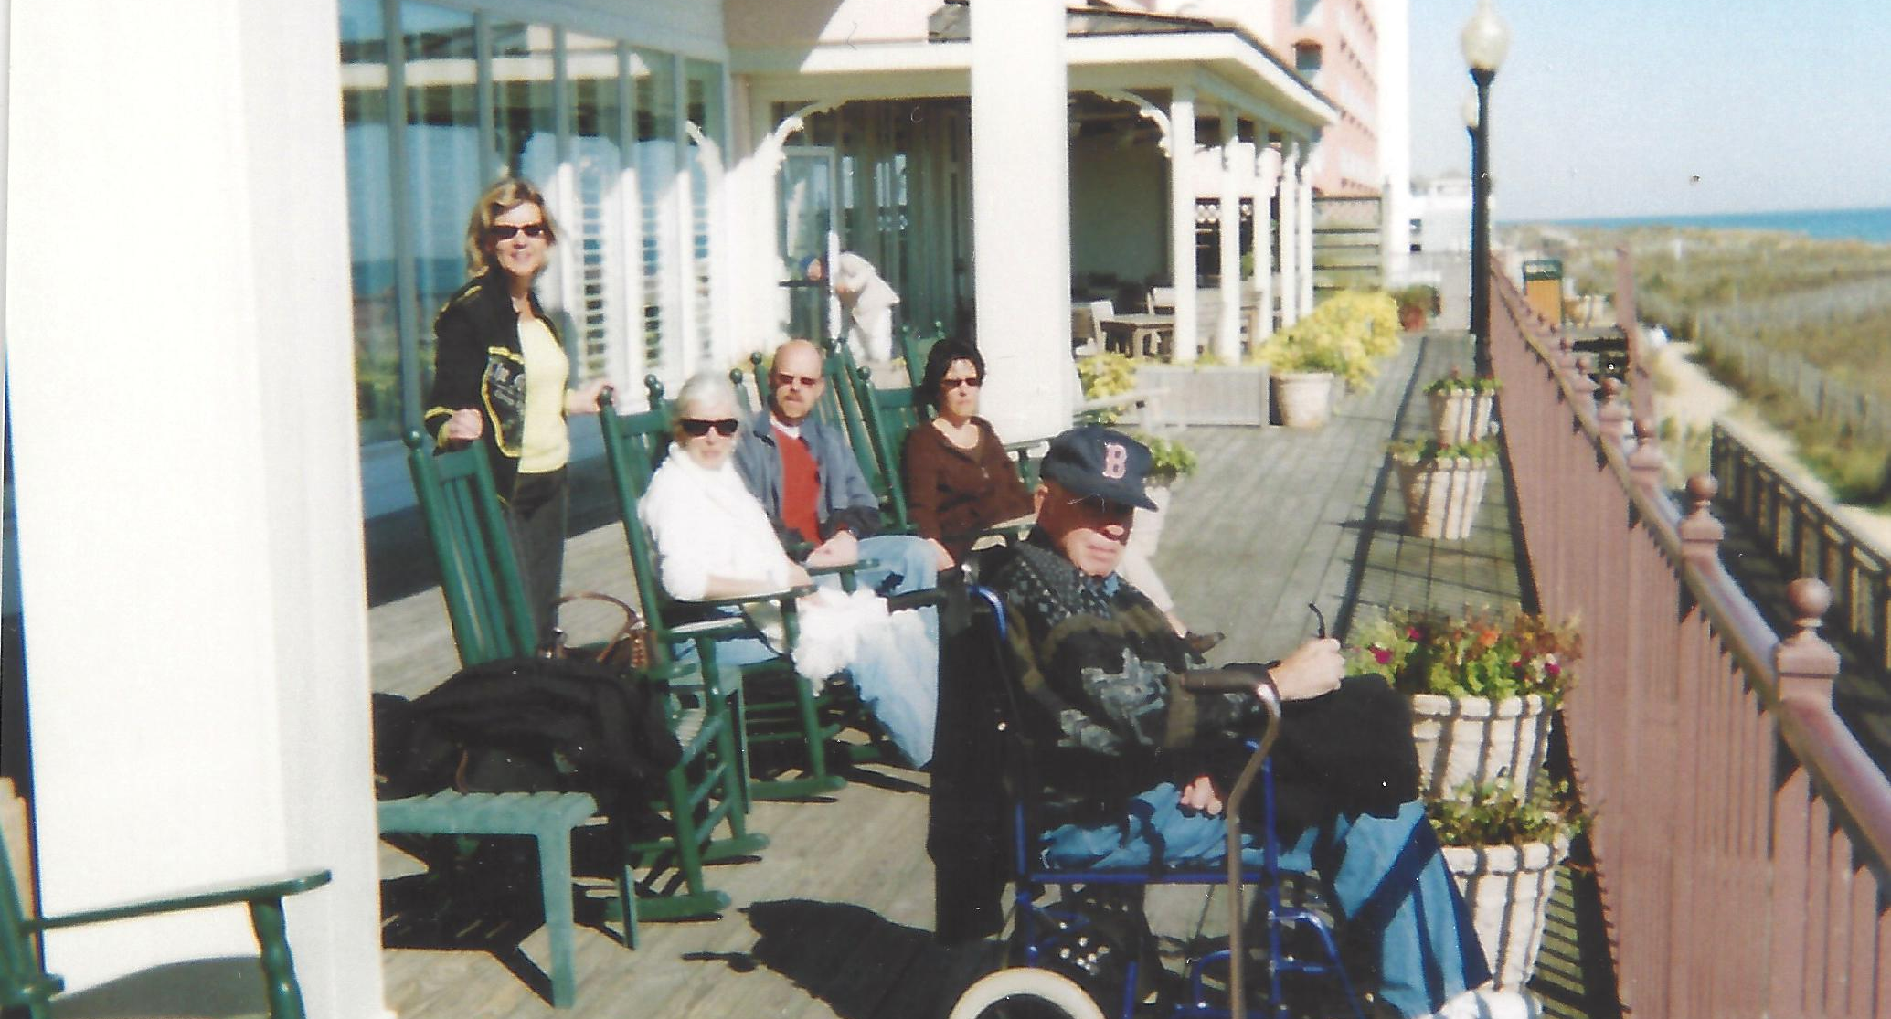

Slide 16
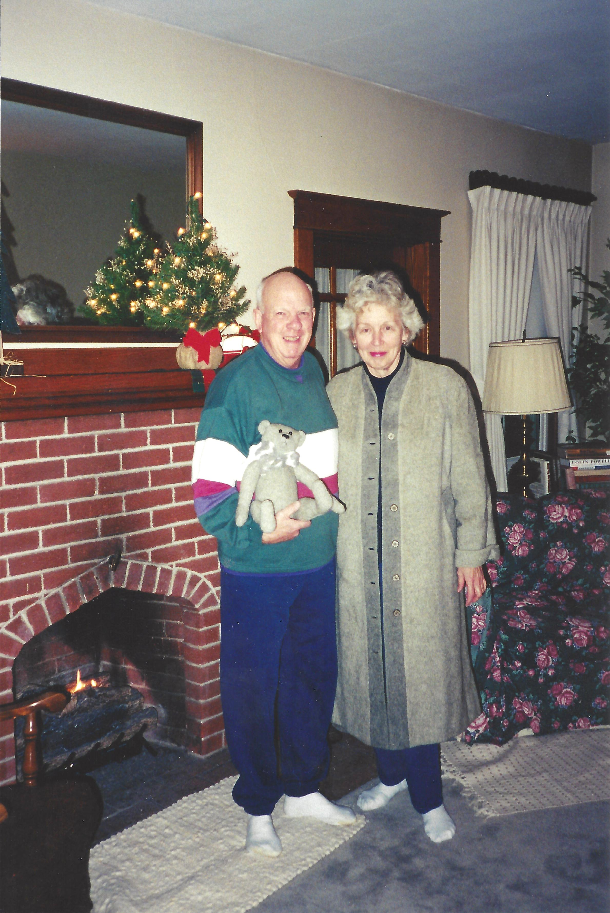
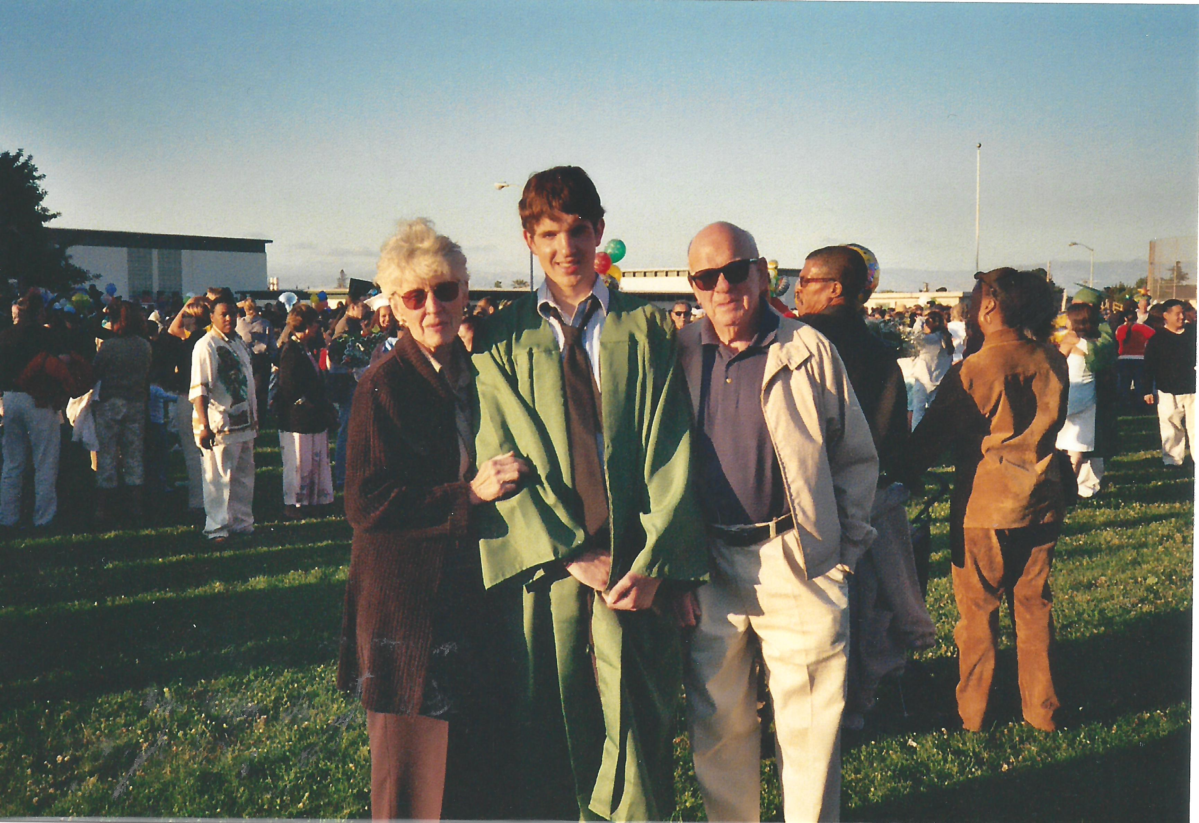

Slide 17
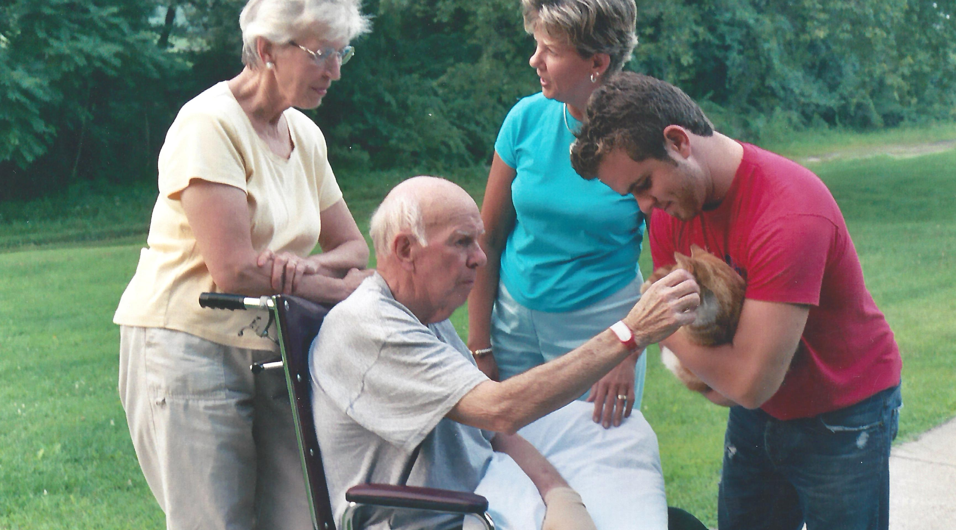

Slide 18
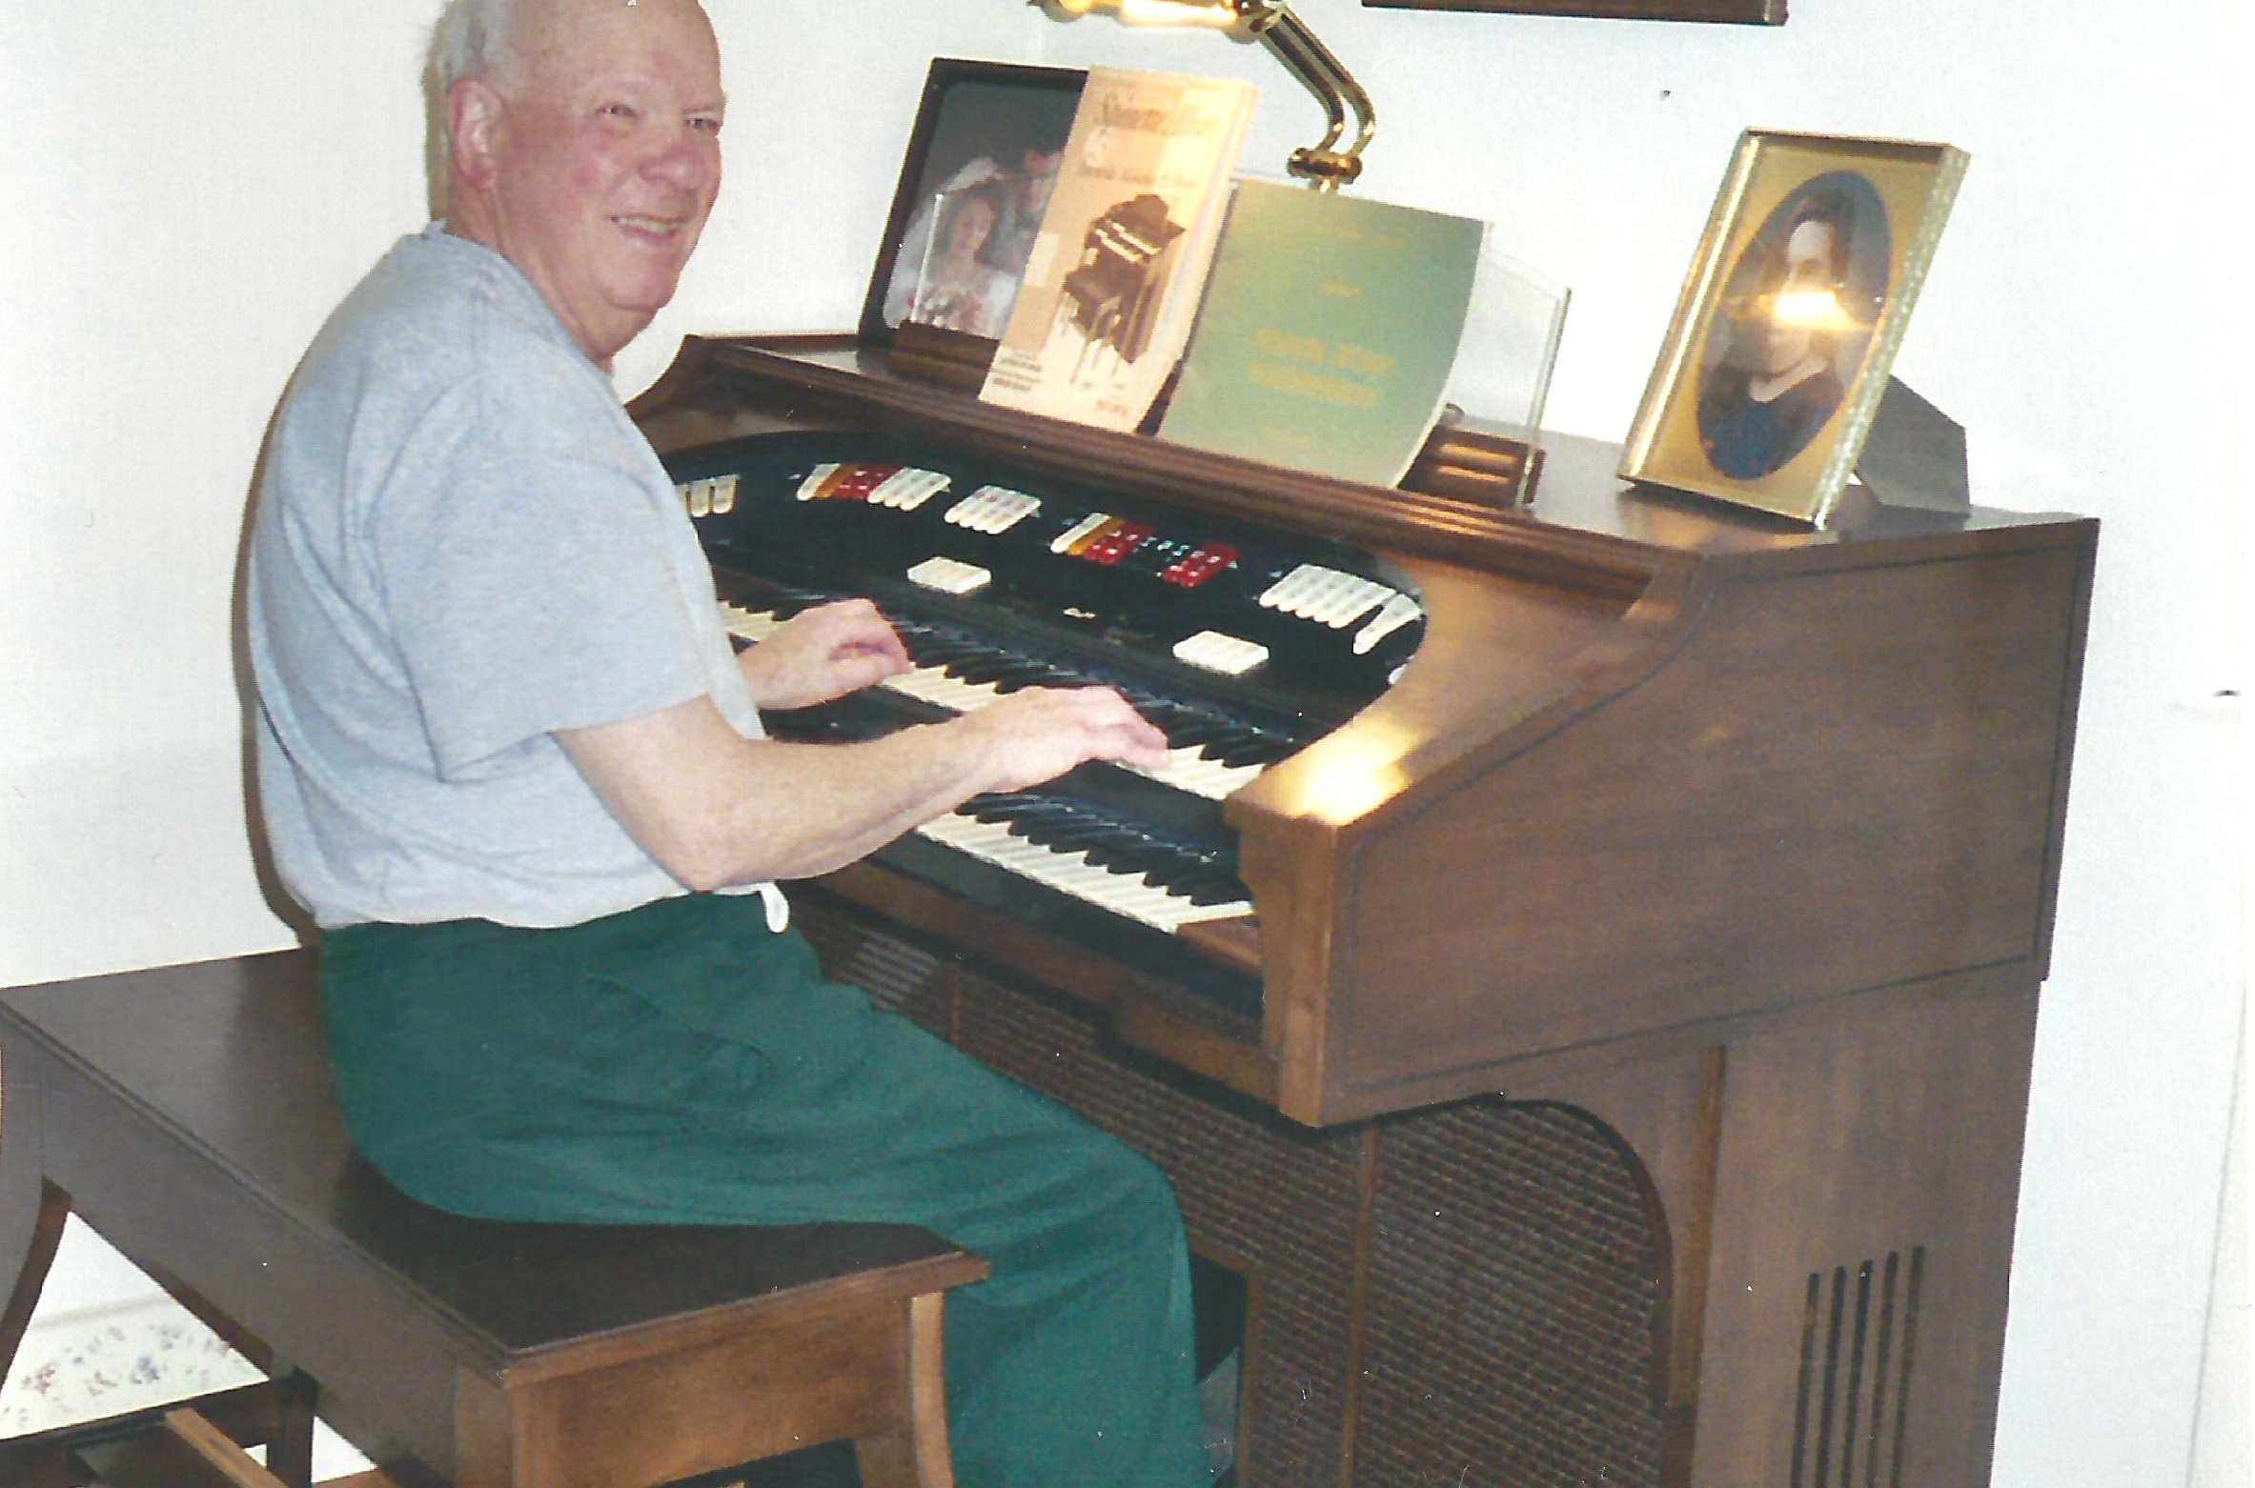

Slide 19
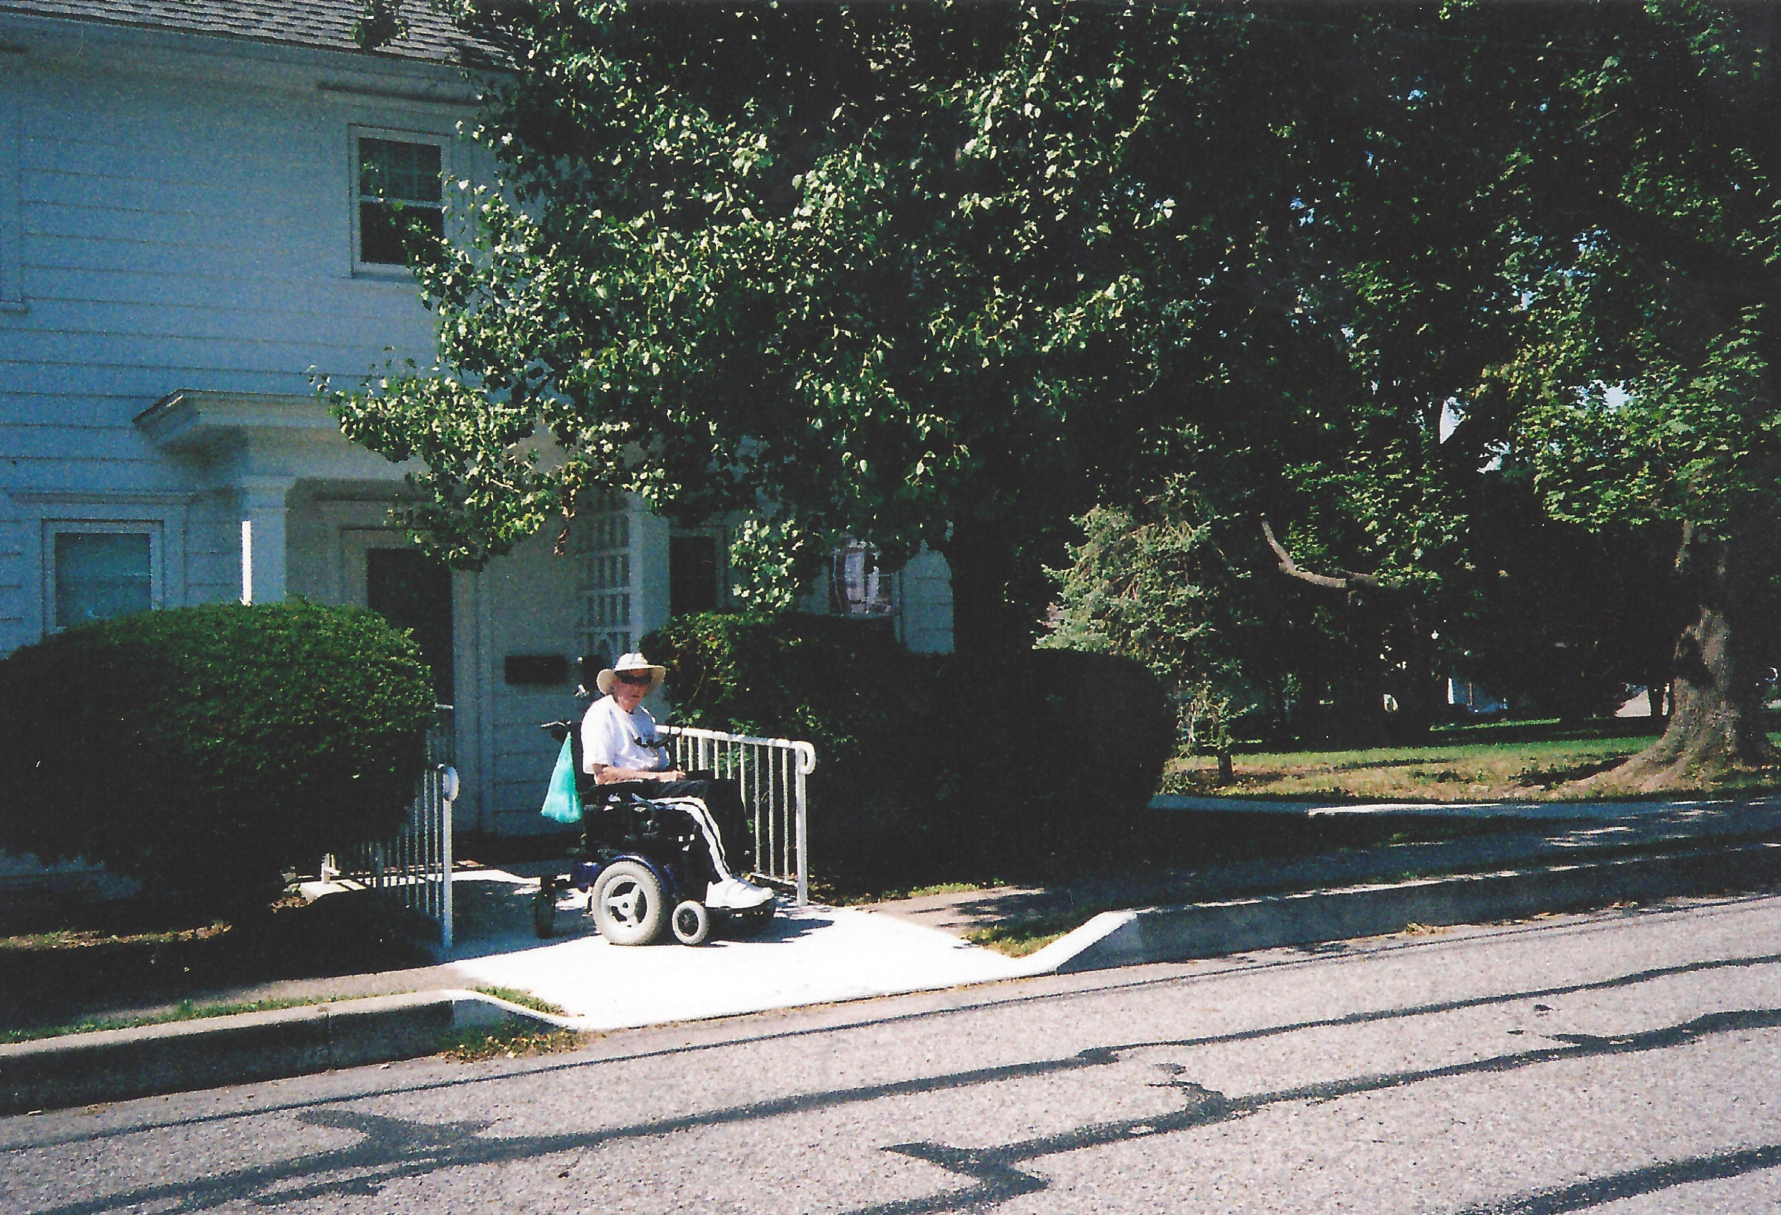
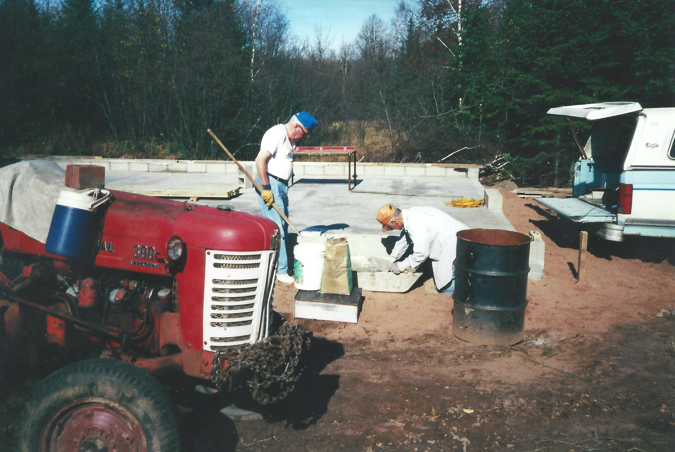
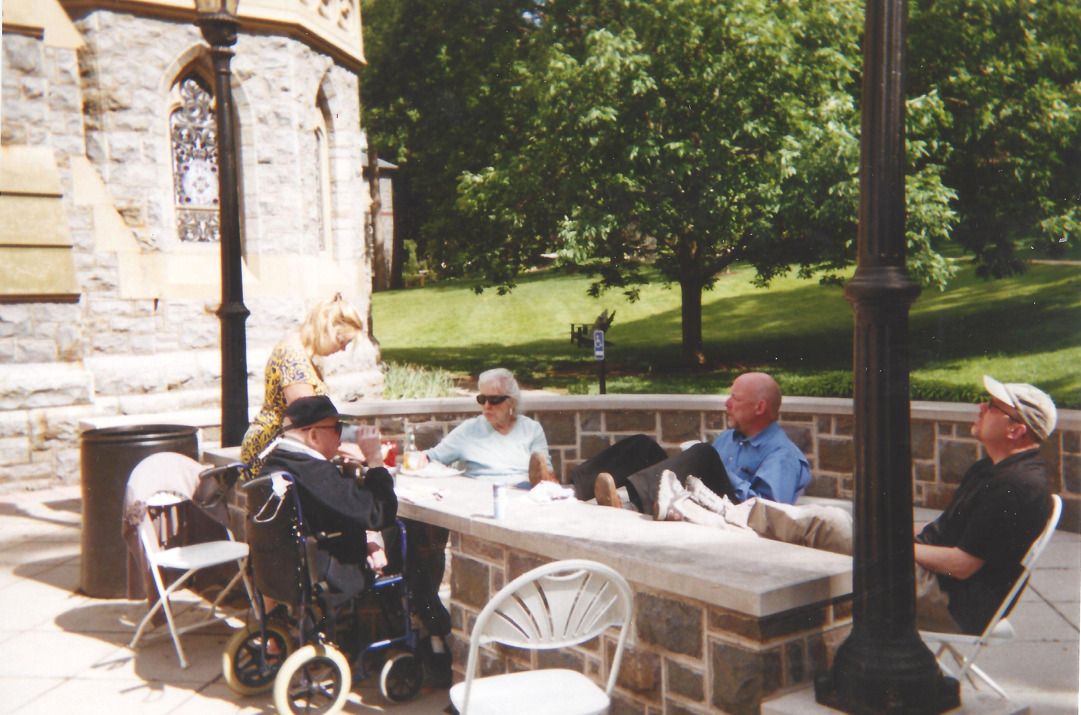

Slide 27
Costa Rica mission trip

Slide 50
Princess, man’s best friend

Slide 52
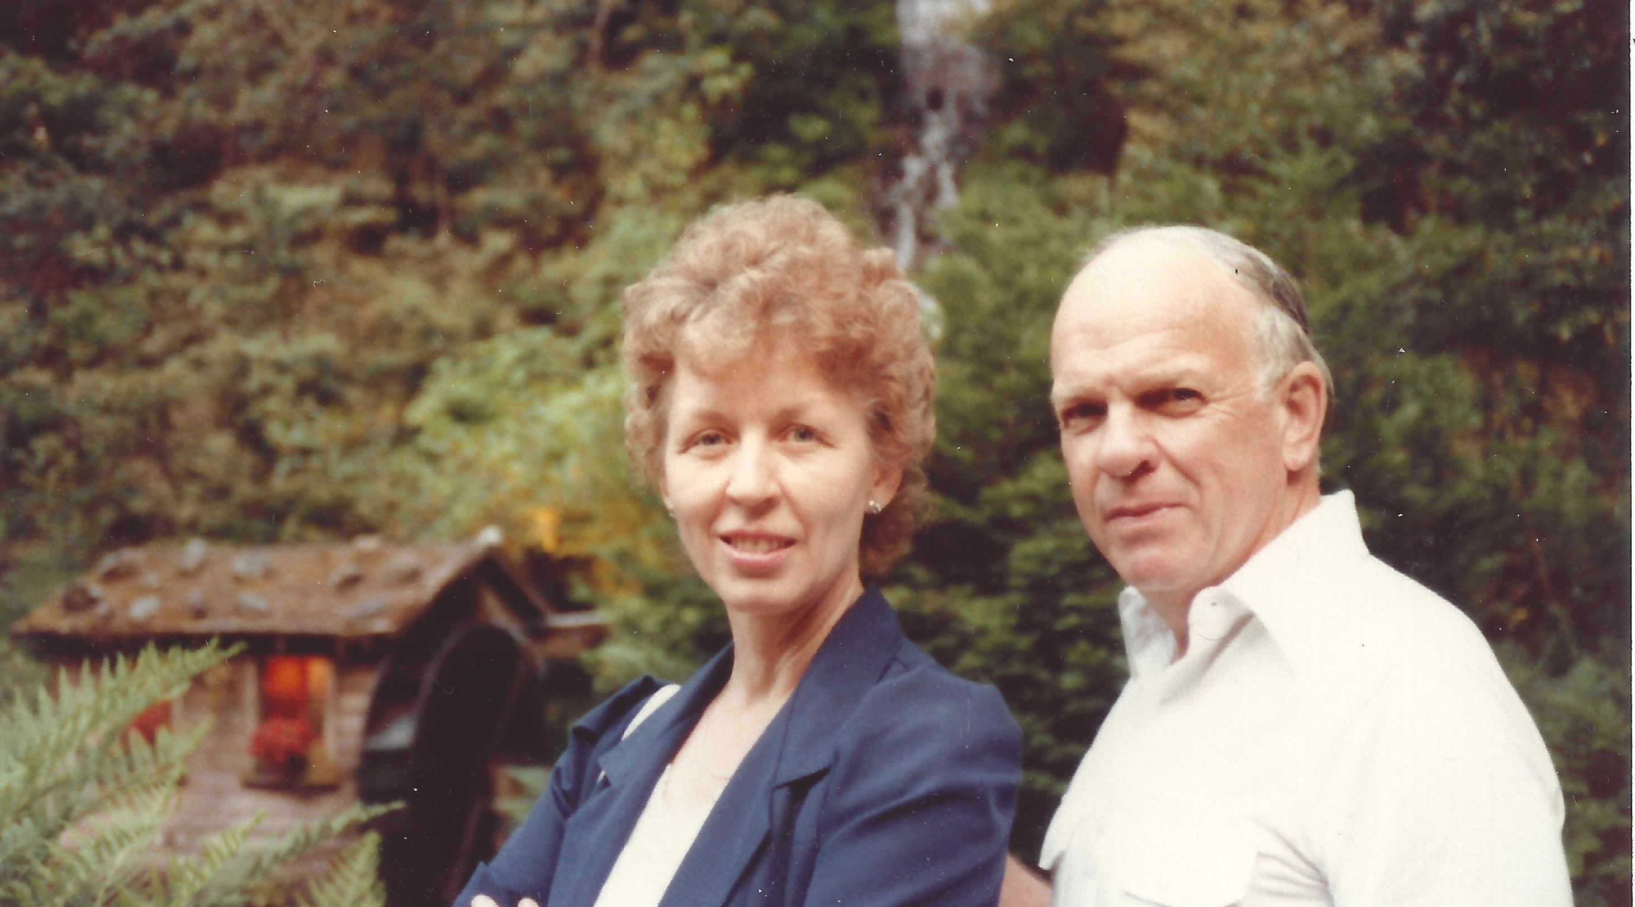

Slide 59
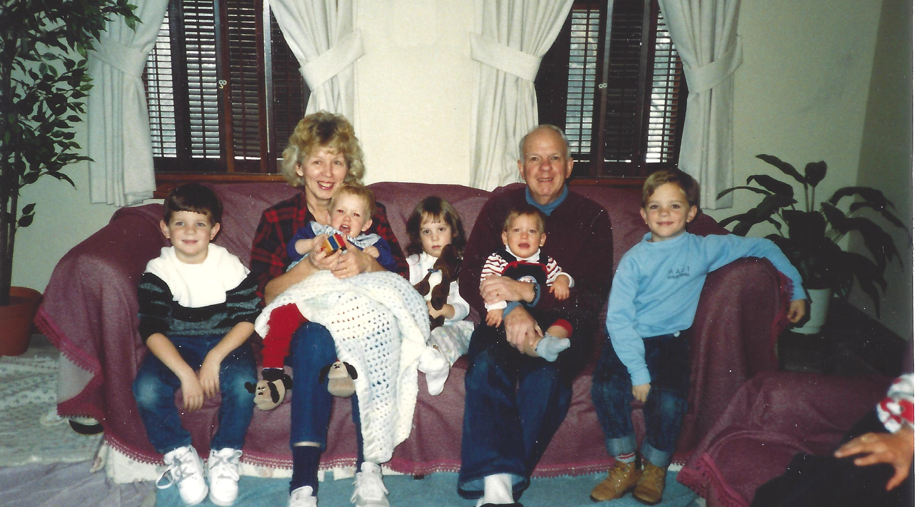

Slide 62
a serious man

